Slide 1
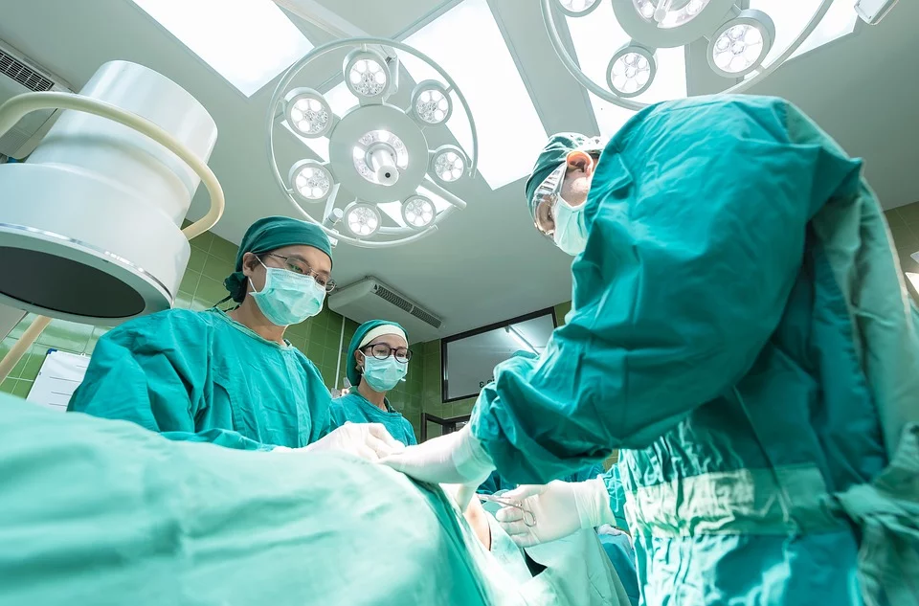







Disorders and Diseases Related to Cell Malfunction During the Cell Cycle

Slide 2
Cell cycle errors may increase the likelihood of the development of some diseases.

Slide 3
Many of these diseases can severely impact how people lead their lives.

Slide 4
How do errors in cell cycle checkpoints affect the likelihood of the development of diseases?

Slide 5
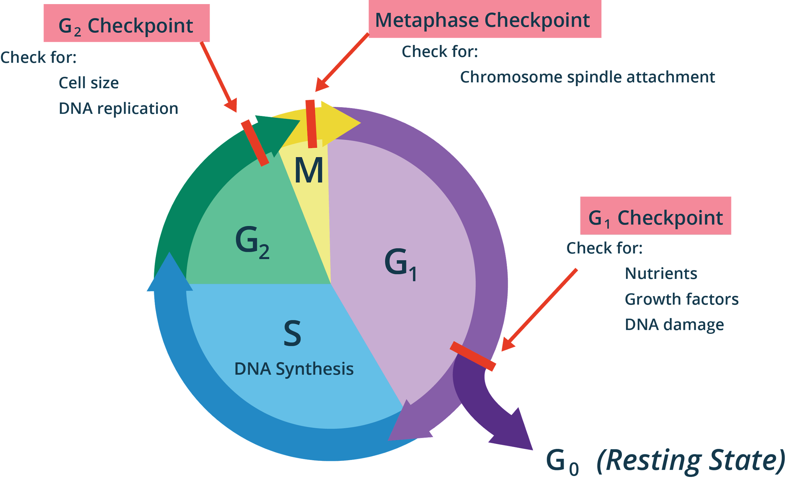
Errors in the Cell Cycle
Cell Cycle Errors
The cell cycle

Slide 6
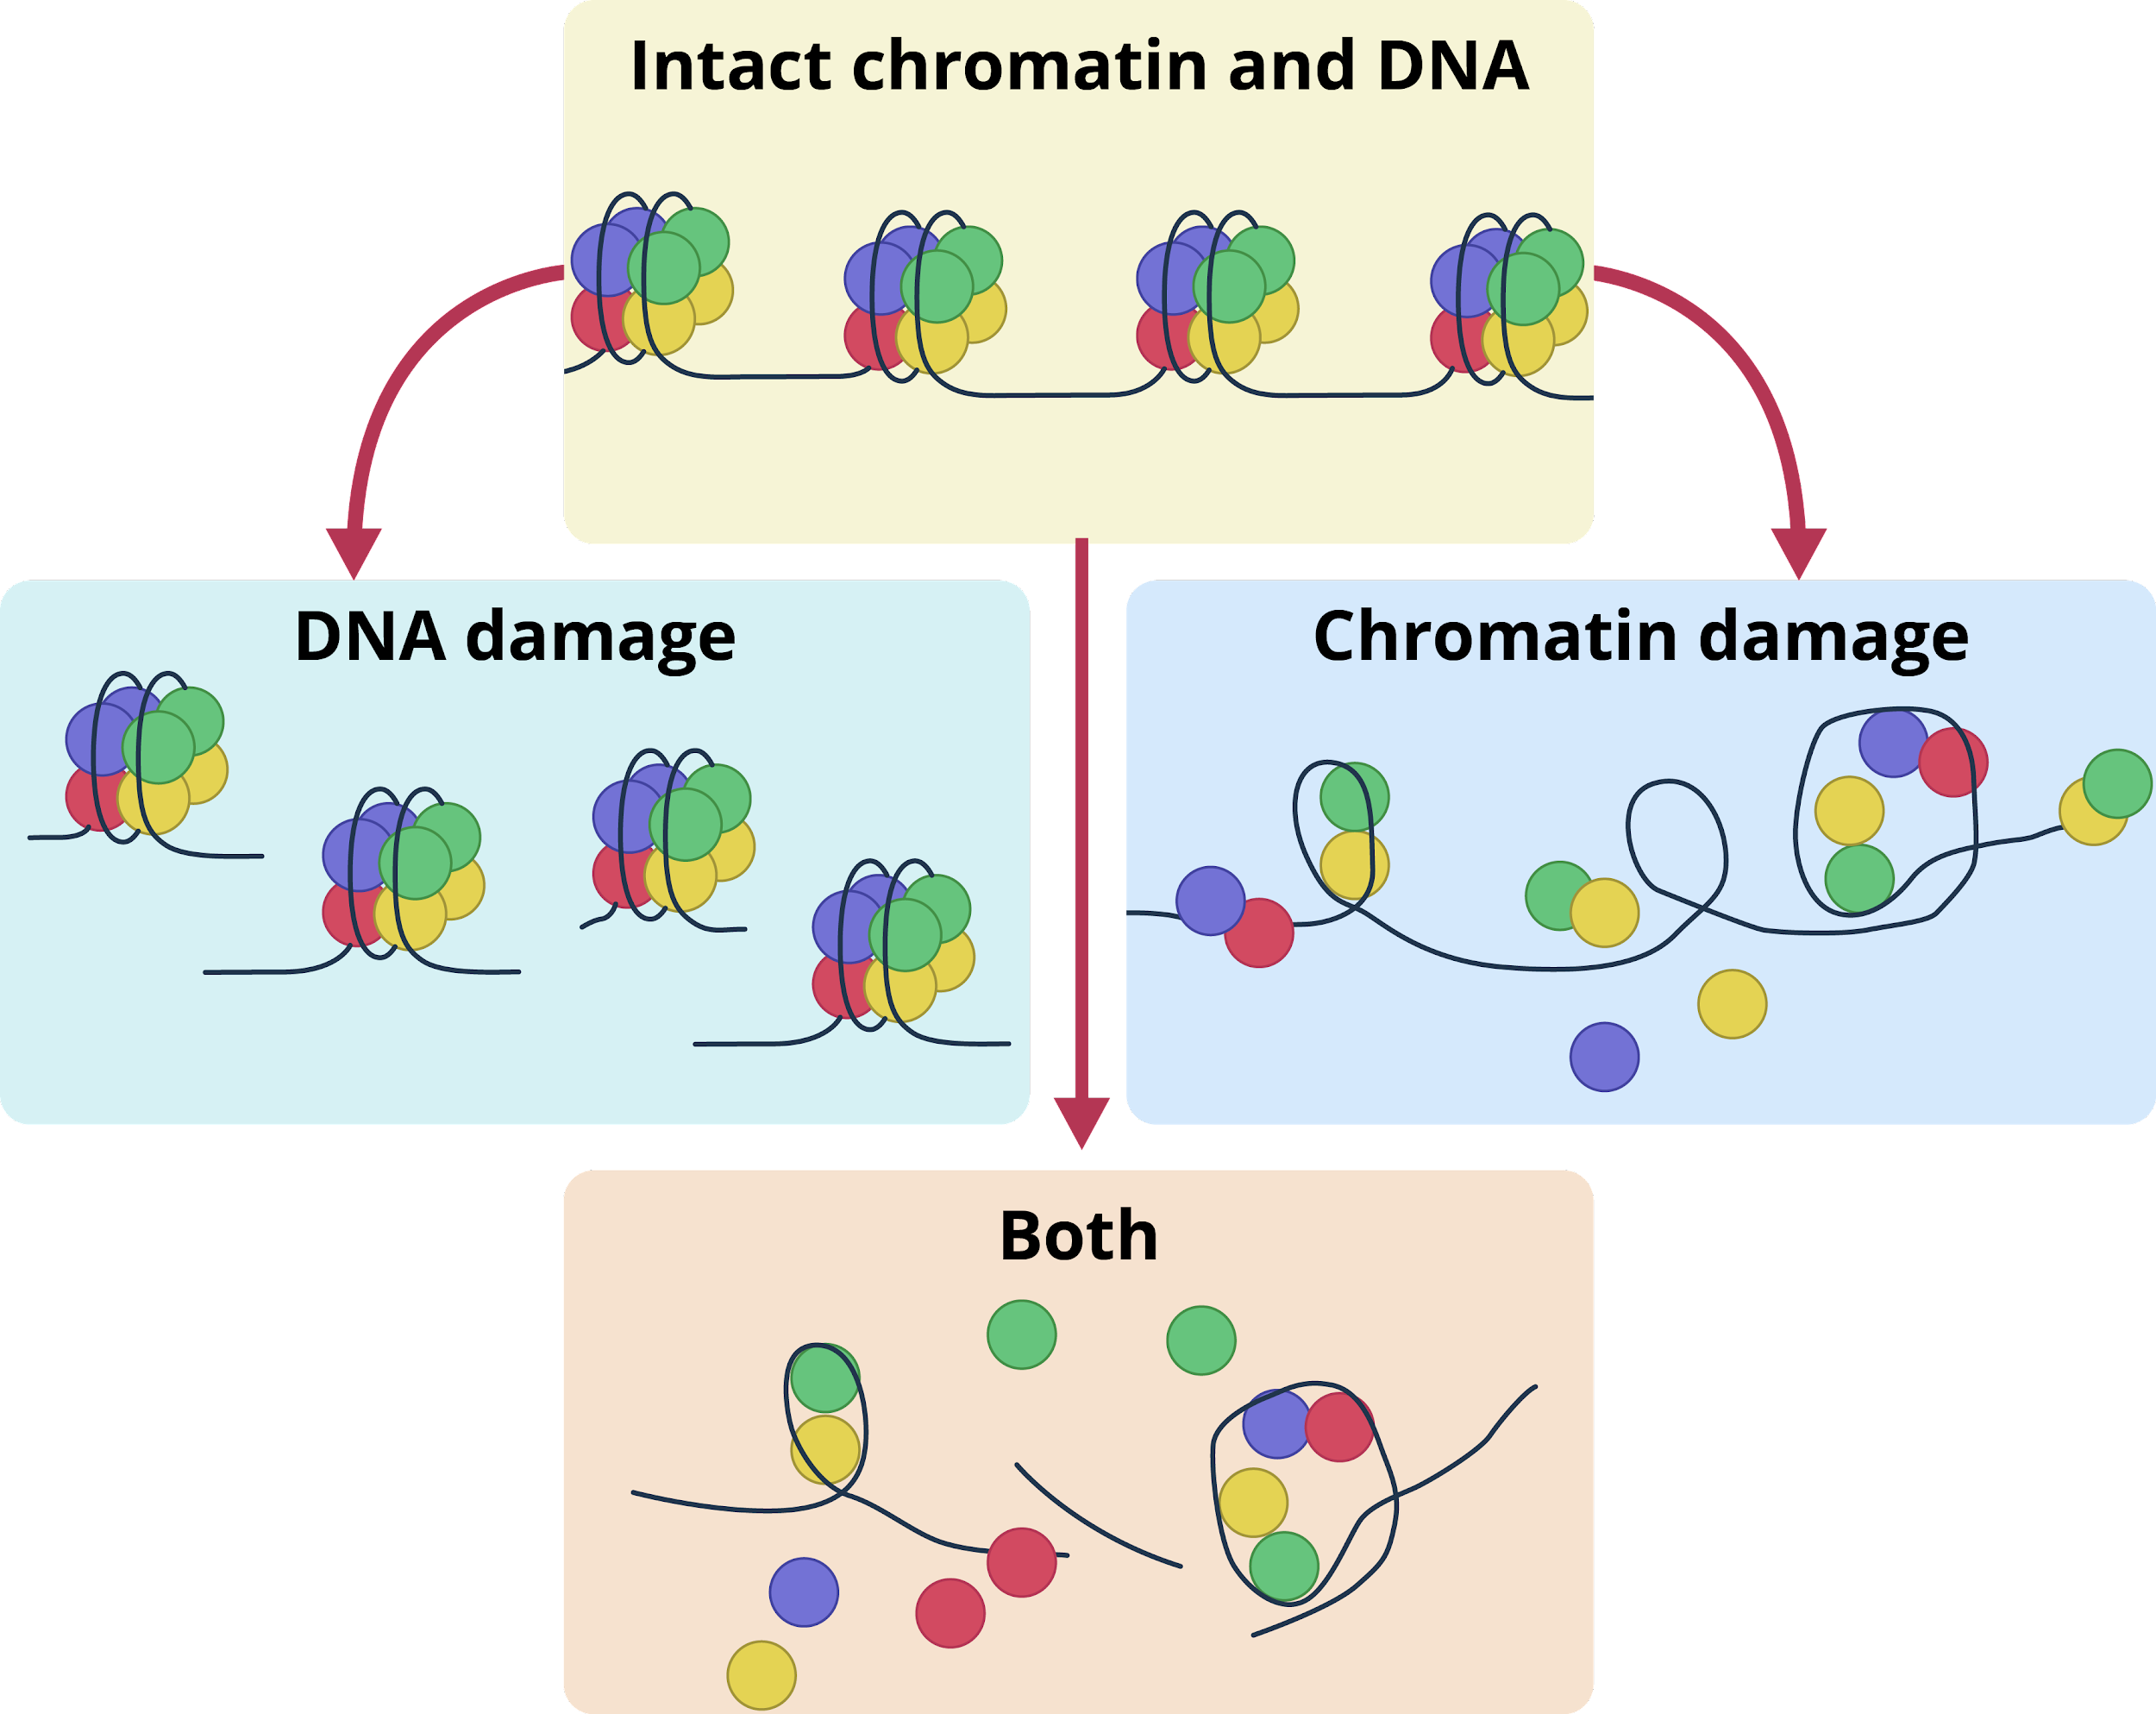
Errors in the Cell Cycle
Mitotic Errors
In mitosis, errors can be passed on in the form of DNA modifications or damage.
Damage in DNA structure and chromatin

Slide 7
Errors in the Cell Cycle
Mitotic Errors
Any errors accumulated in the parent cell have the capacity to be passed on to the daughter cells.
Damage in DNA structure and chromatin

Slide 8
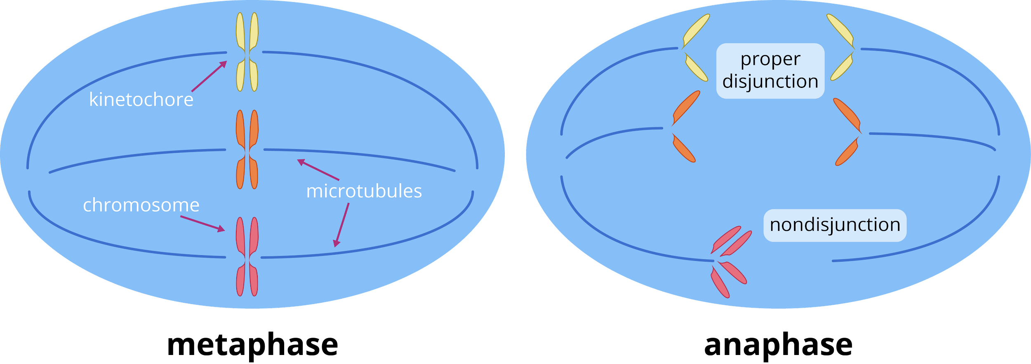
Errors in the Cell Cycle
Mitotic and Meiotic Errors
Failure of the chromosomes or chromatids to separate properly is known as nondisjunction. This results in an abnormal amount of DNA.

Slide 9
Errors in the Cell Cycle
Mitotic and Meiotic Errors
This can also occur during mitosis where the pairs of chromosomes do not separate properly. If this occurs, it is known as mitotic nondisjunction.

Slide 10
What can possibly happen to the daughter cells if they contain more or less than the normal amount of chromosomes that humans are supposed to have?

Slide 11
Cell Cycle Diseases and Disorders
Cancer
1. error in cell cycle checkpoints
2. abnormal cell growth
Nondisjunction disorders
Mosaicism
3. neoplasm
4. tumor
Alzheimer’s disease
Microcephaly
Process on how a cell becomes a tumor
Psychiatric diseases

Slide 12
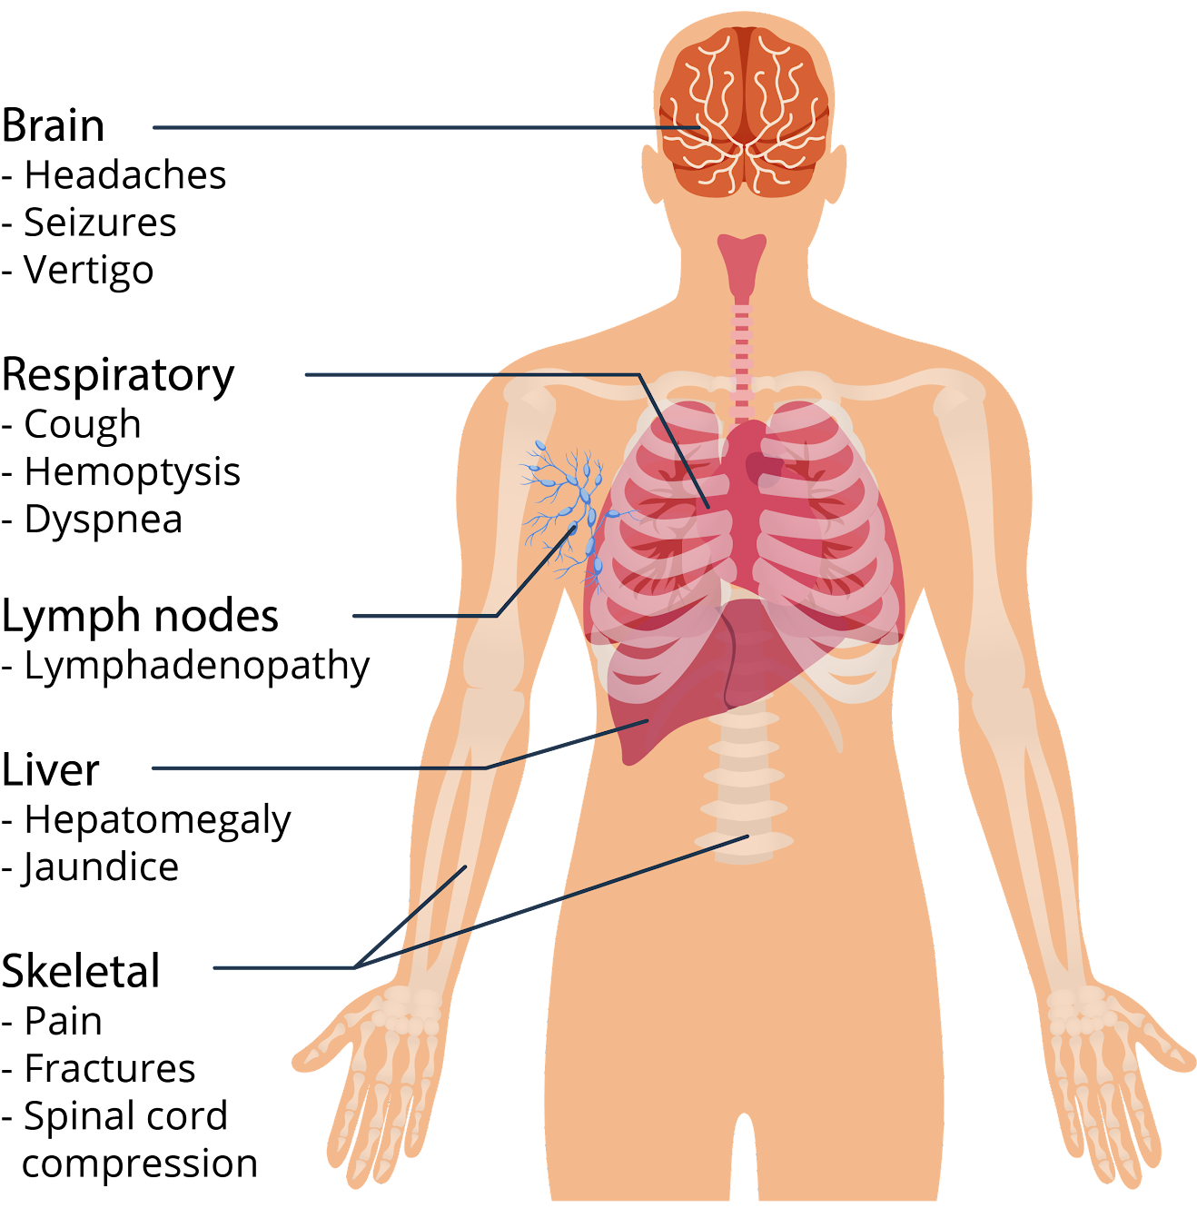
Cell Cycle Diseases and Disorders
Cancer
Nondisjunction disorders
Mosaicism
Alzheimer’s disease
Microcephaly
Psychiatric diseases
Common sites and symptoms of cancer metastasis

Slide 13
Cell Cycle Diseases and Disorders
Cancer
cigarettes and alcohol
heredity
obesity
Nondisjunction disorders
Mosaicism
Factors that can cause cancer
Alzheimer’s disease
Microcephaly
exposure to radiation
exposure to pollution
exposure to carcinogens
Psychiatric diseases

Slide 14
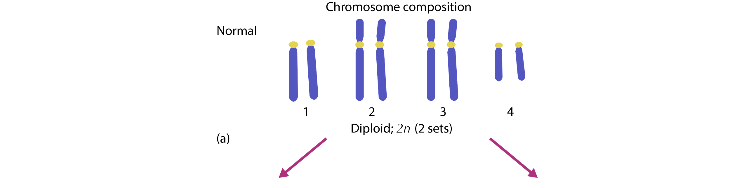
Cell Cycle Diseases and Disorders
Cancer
Nondisjunction disorders
Mosaicism
Alzheimer’s disease
Microcephaly
Psychiatric diseases
Effects of nondisjunction

Slide 15
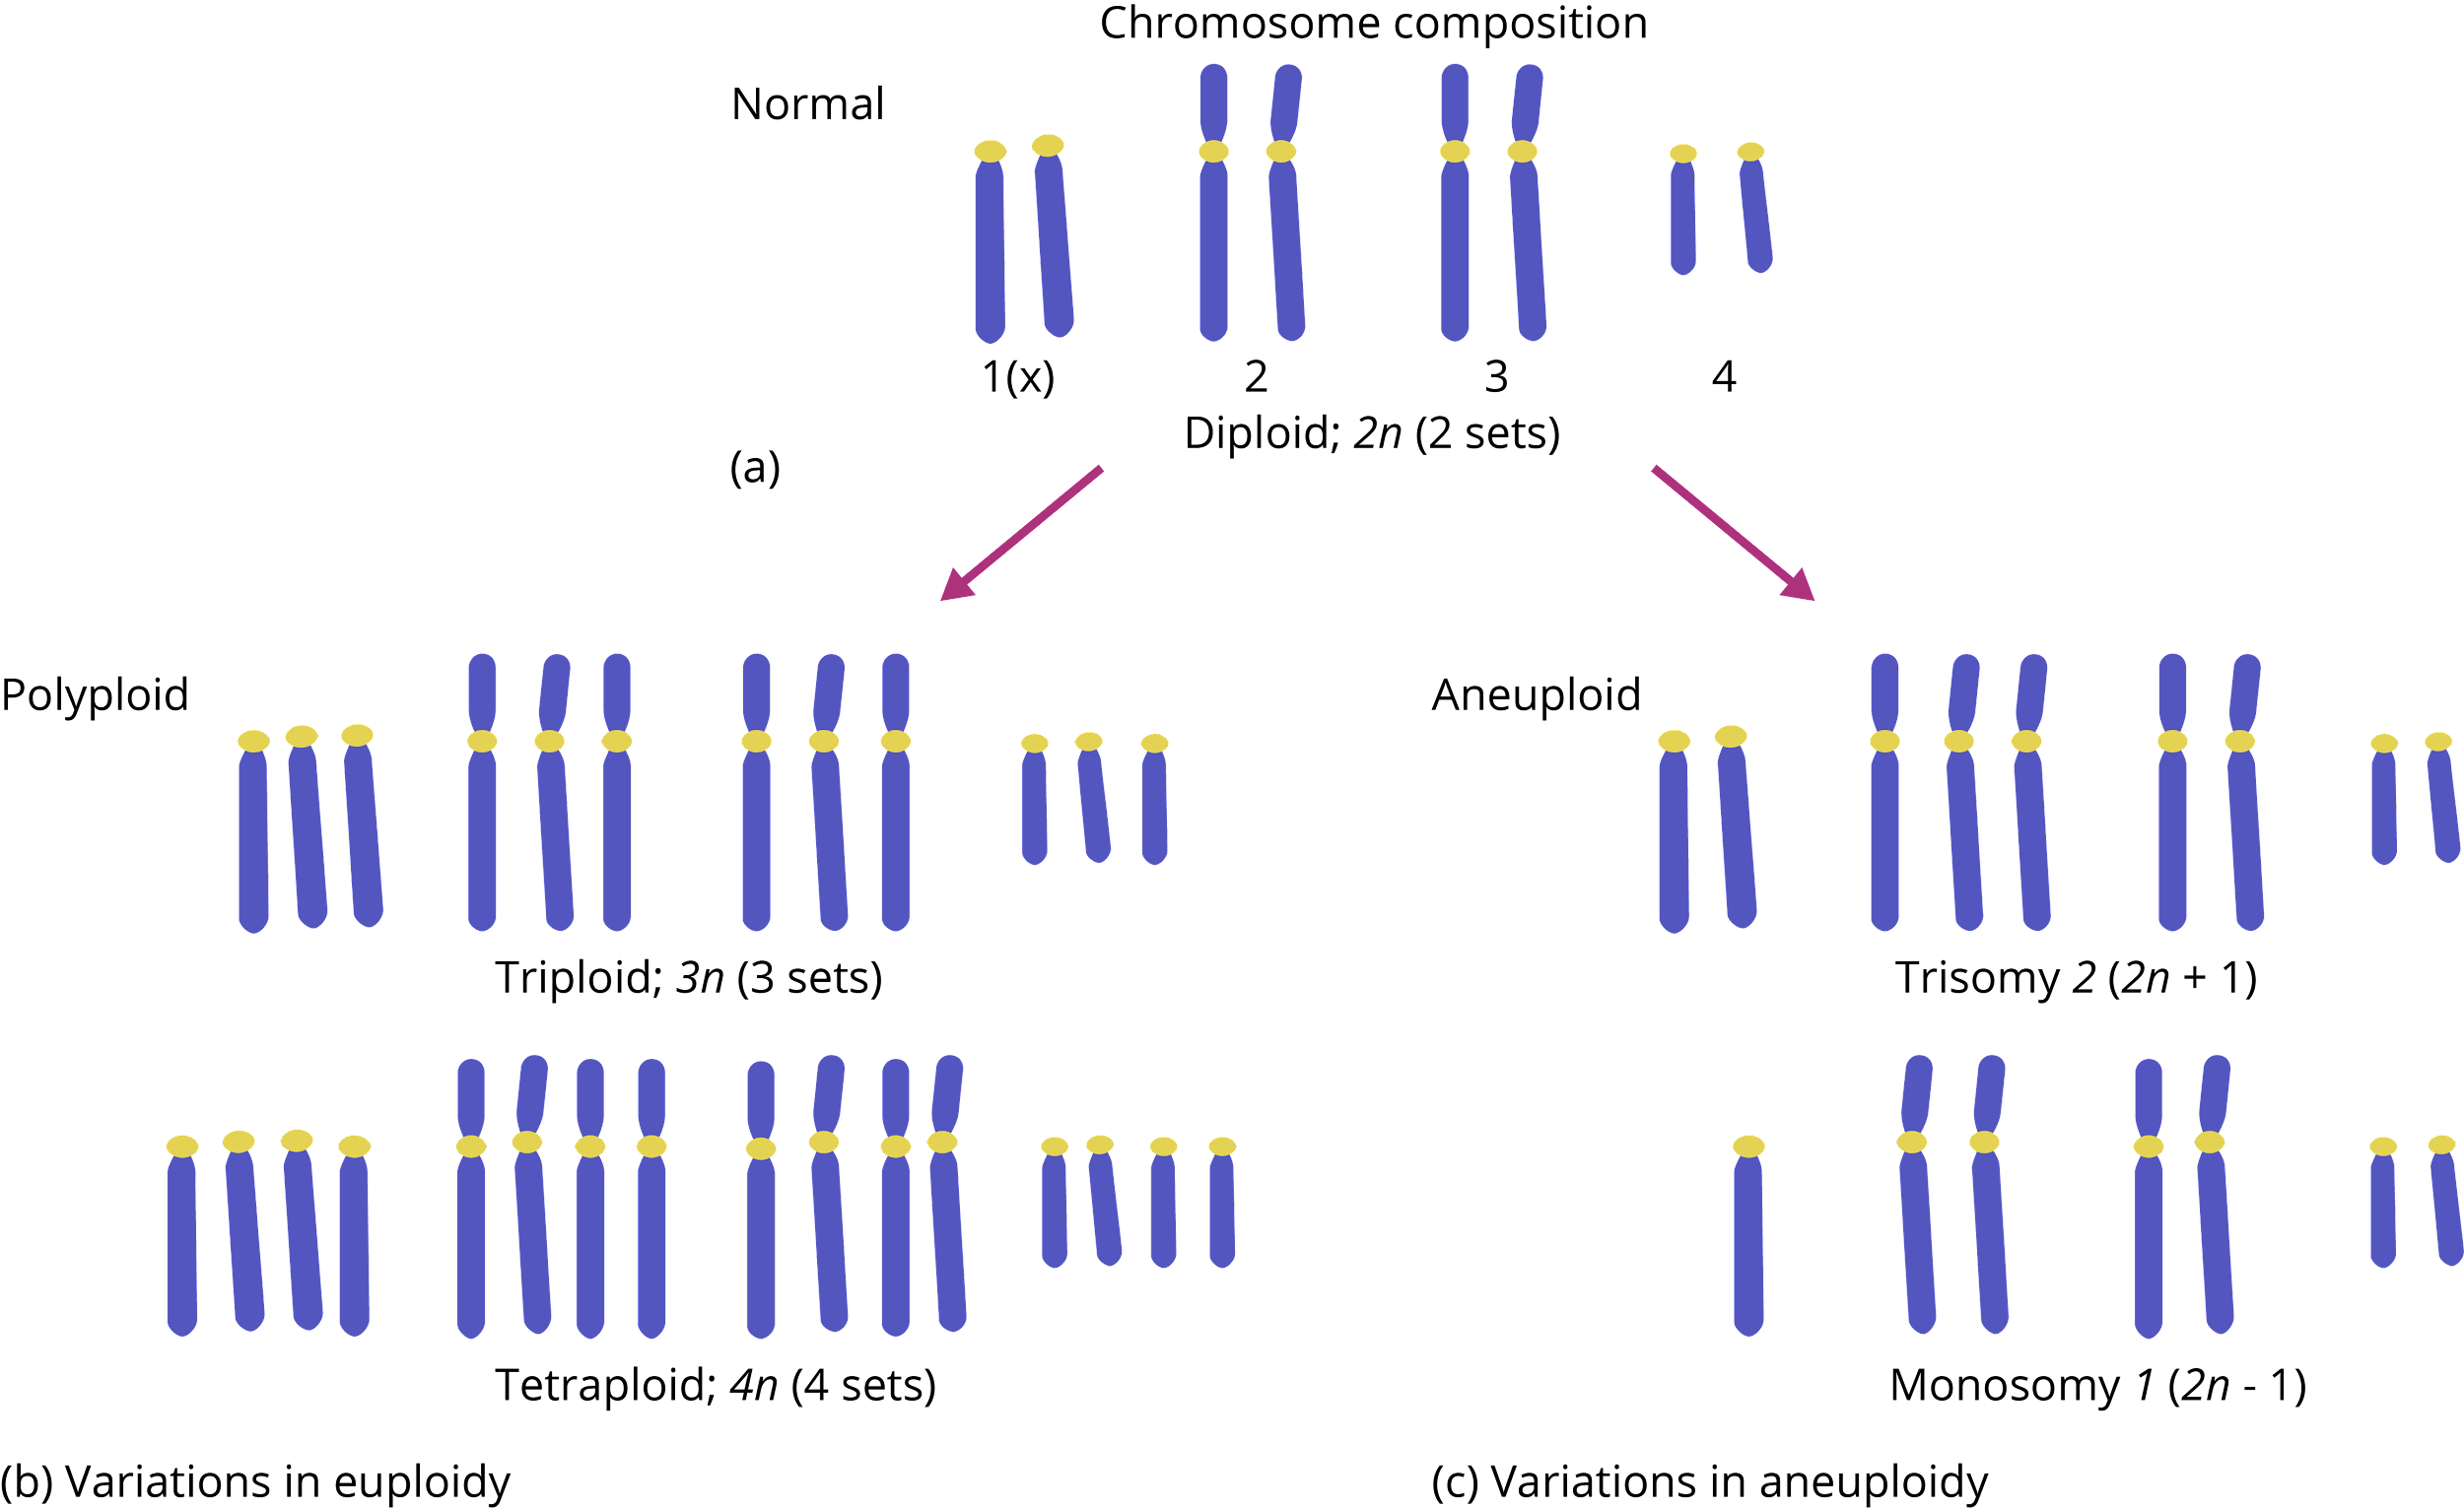
Cell Cycle Diseases and Disorders
Cancer
abnormal number of sets of chromosomes
Nondisjunction disorders
Mosaicism
Alzheimer’s disease
Microcephaly
Psychiatric diseases
Effects of nondisjunction

Slide 16
Cell Cycle Diseases and Disorders
Cancer
abnormal number of chromosomes
Nondisjunction disorders
Mosaicism
Alzheimer’s disease
Microcephaly
Psychiatric diseases
Effects of nondisjunction

Slide 17
Cell Cycle Diseases and Disorders
Cancer
abnormal number of sets of chromosomes
abnormal number of chromosomes
Nondisjunction disorders
Mosaicism
Alzheimer’s disease
Microcephaly
Psychiatric diseases
Effects of nondisjunction

Slide 18
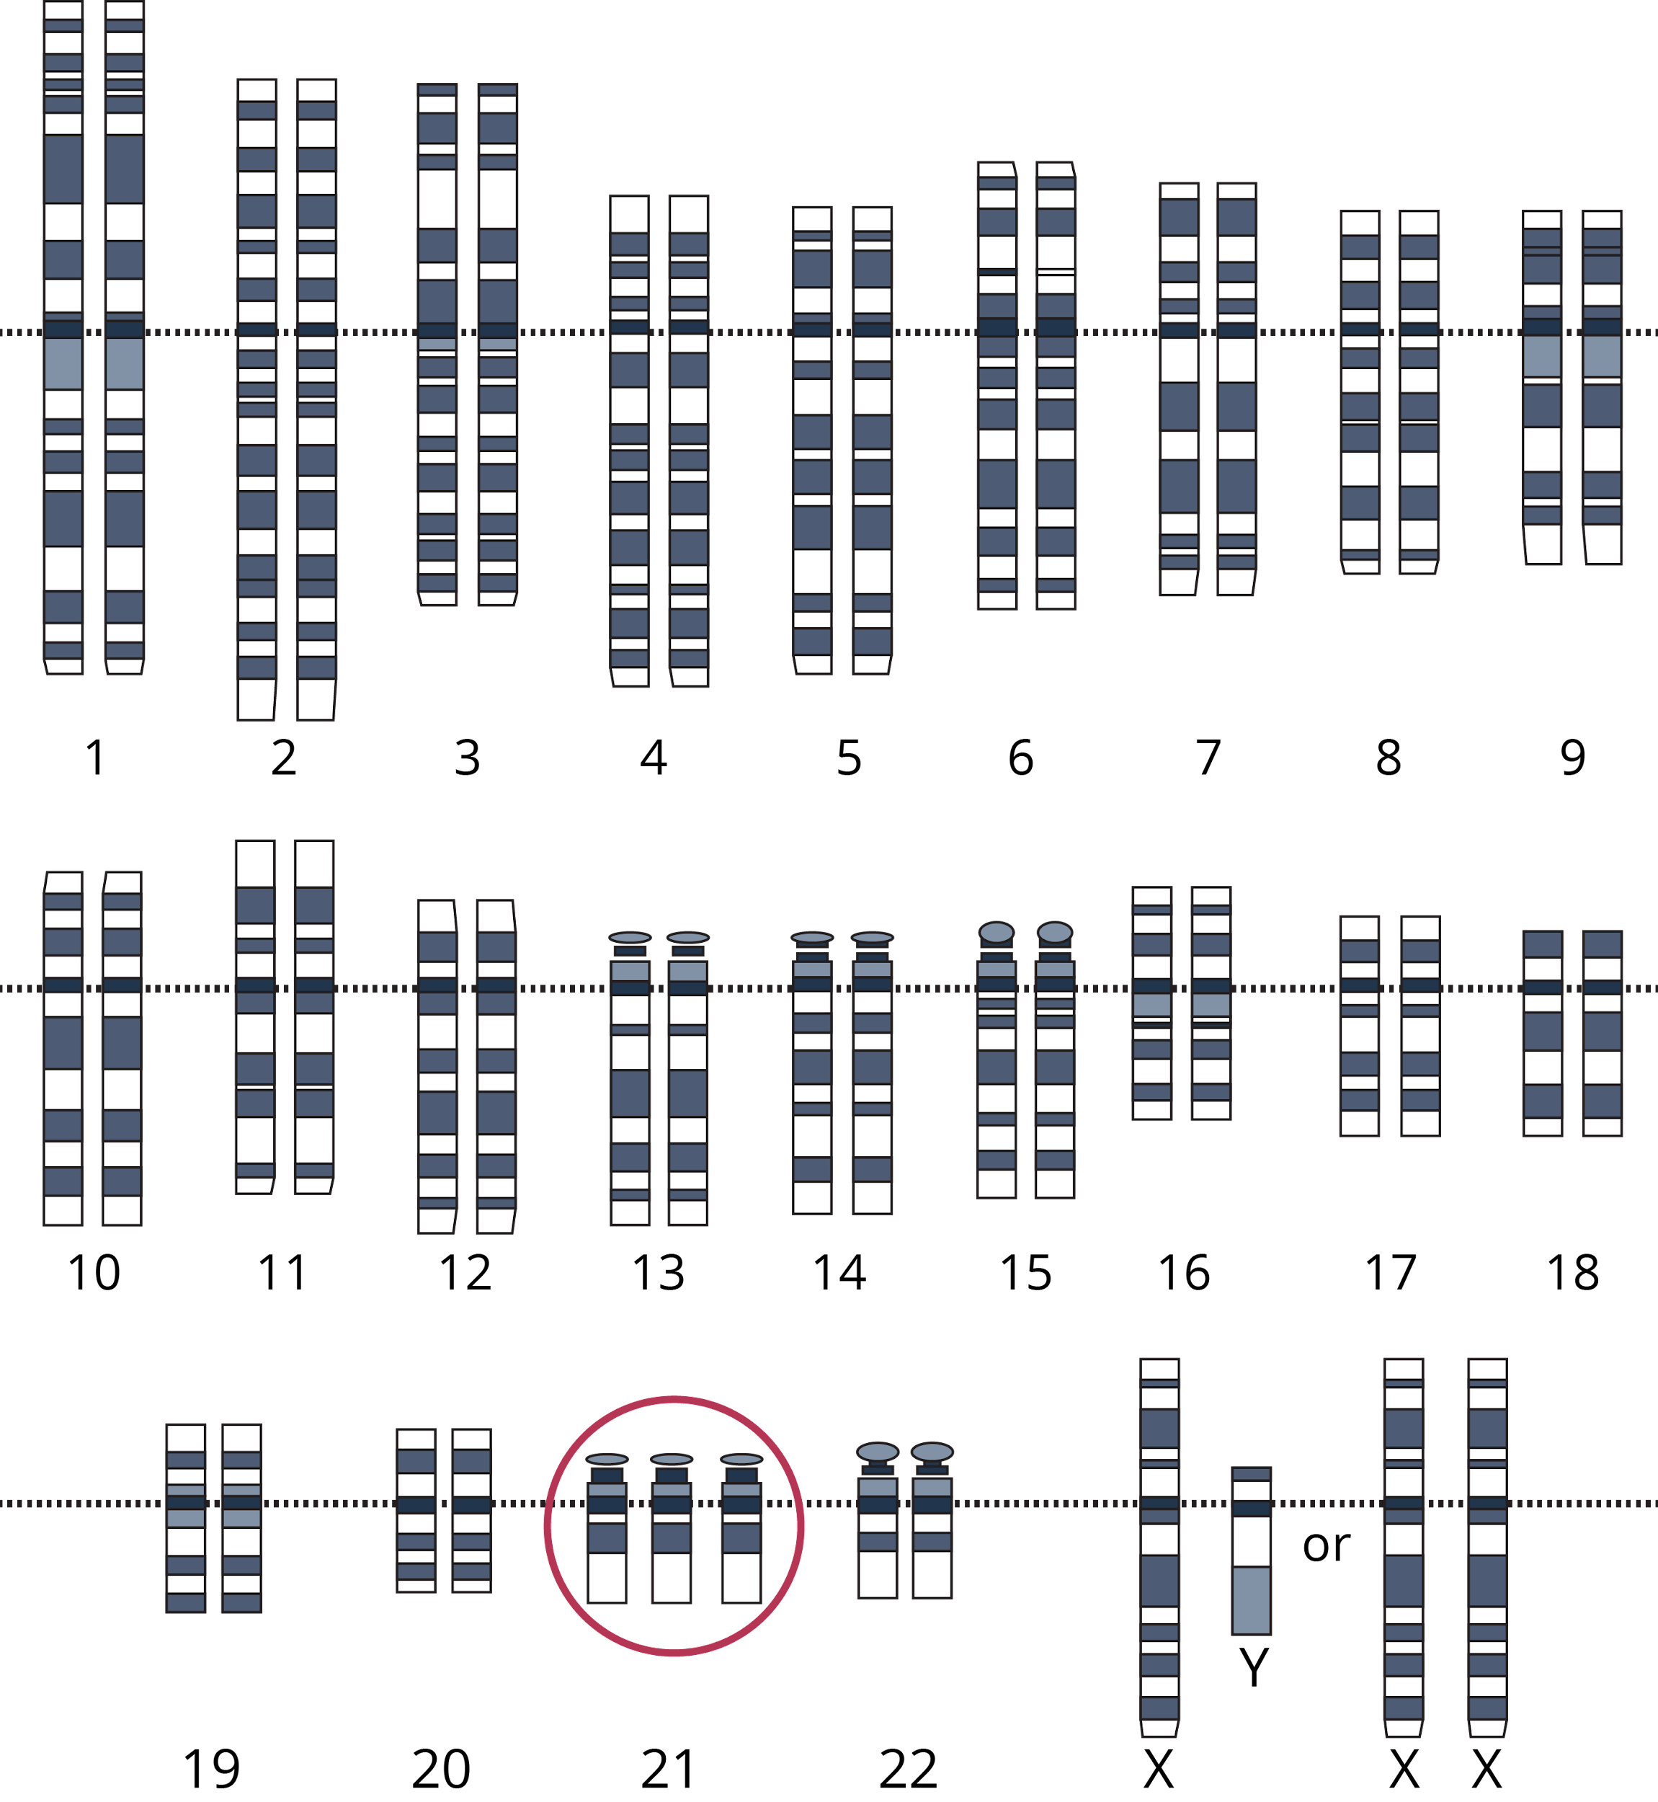
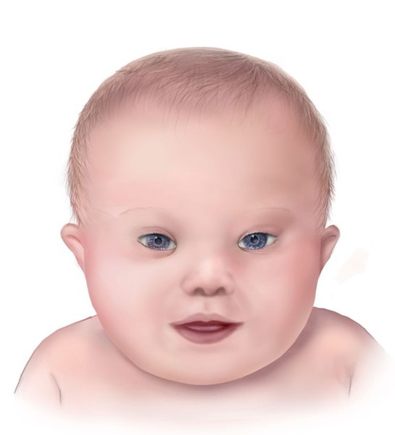
Cell Cycle Diseases and Disorders
Down’s syndrome
Patau’s syndrome
Turner syndrome
Cancer
Nondisjunction disorders
Mosaicism
Alzheimer’s disease
Microcephaly
Psychiatric diseases
A karyotype of a person with trisomy 21 (left) and
a photo showing some of the distinct facial characteristics associated with Down syndrome (right).

Slide 19
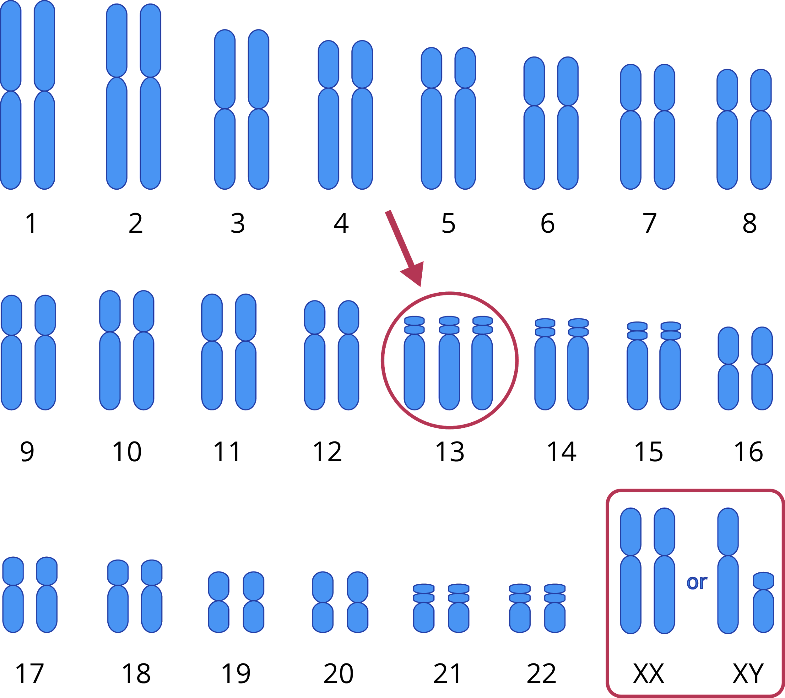
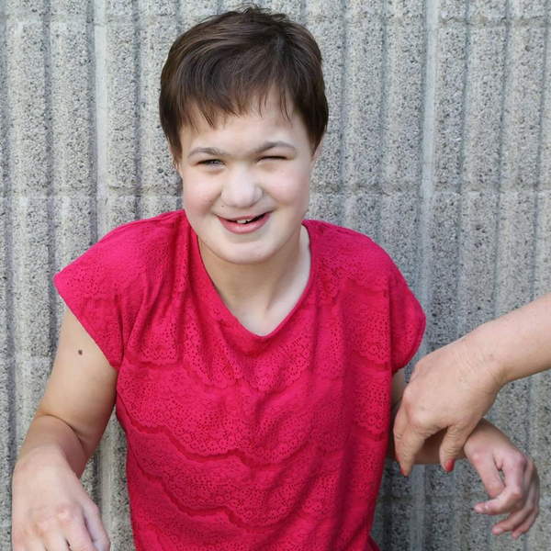
Cell Cycle Diseases and Disorders
Down’s syndrome
Patau’s syndrome
Turner syndrome
Cancer
Nondisjunction disorders
Mosaicism
Alzheimer’s disease
Microcephaly
Psychiatric diseases
A karyotype of a person with trisomy 13 (left) and
a photo showing some of the distinct facial characteristics associated with Patau’s syndrome (right).

Slide 20
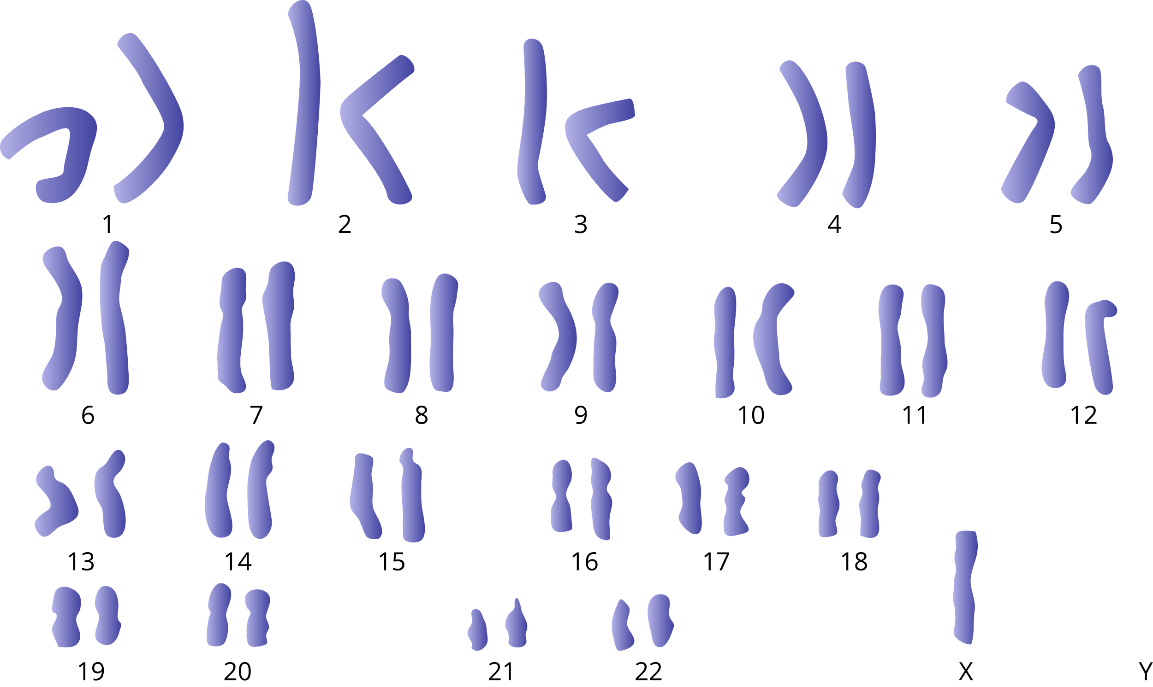
Cell Cycle Diseases and Disorders
Down’s syndrome
Patau’s syndrome
Turner syndrome
Cancer
Nondisjunction disorders
Mosaicism
Alzheimer’s disease
Microcephaly
Psychiatric diseases
A karyotype of a person with Turner syndrome

Slide 21
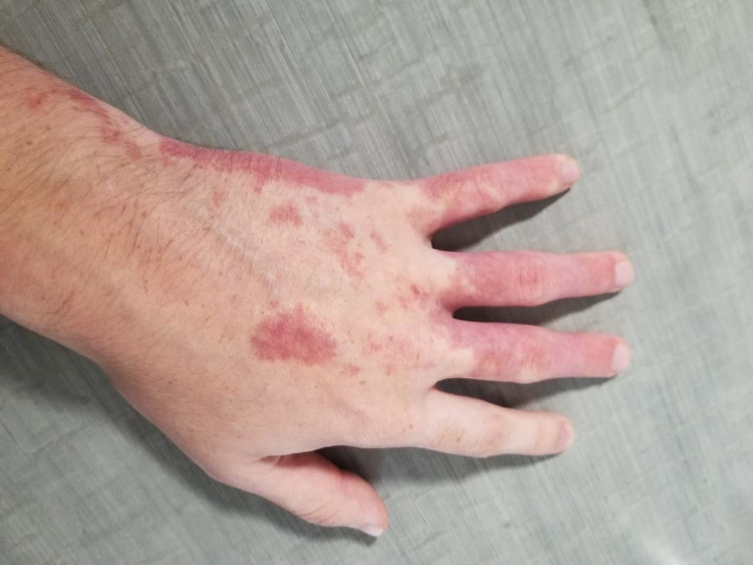
Cell Cycle Diseases and Disorders
Cancer
Nondisjunction disorders
Mosaicism
Alzheimer’s disease
Microcephaly
Psychiatric diseases
Skin discolorations are characterized by person with a mosaic form of Klippel–Trénaunay syndrome.

Slide 22
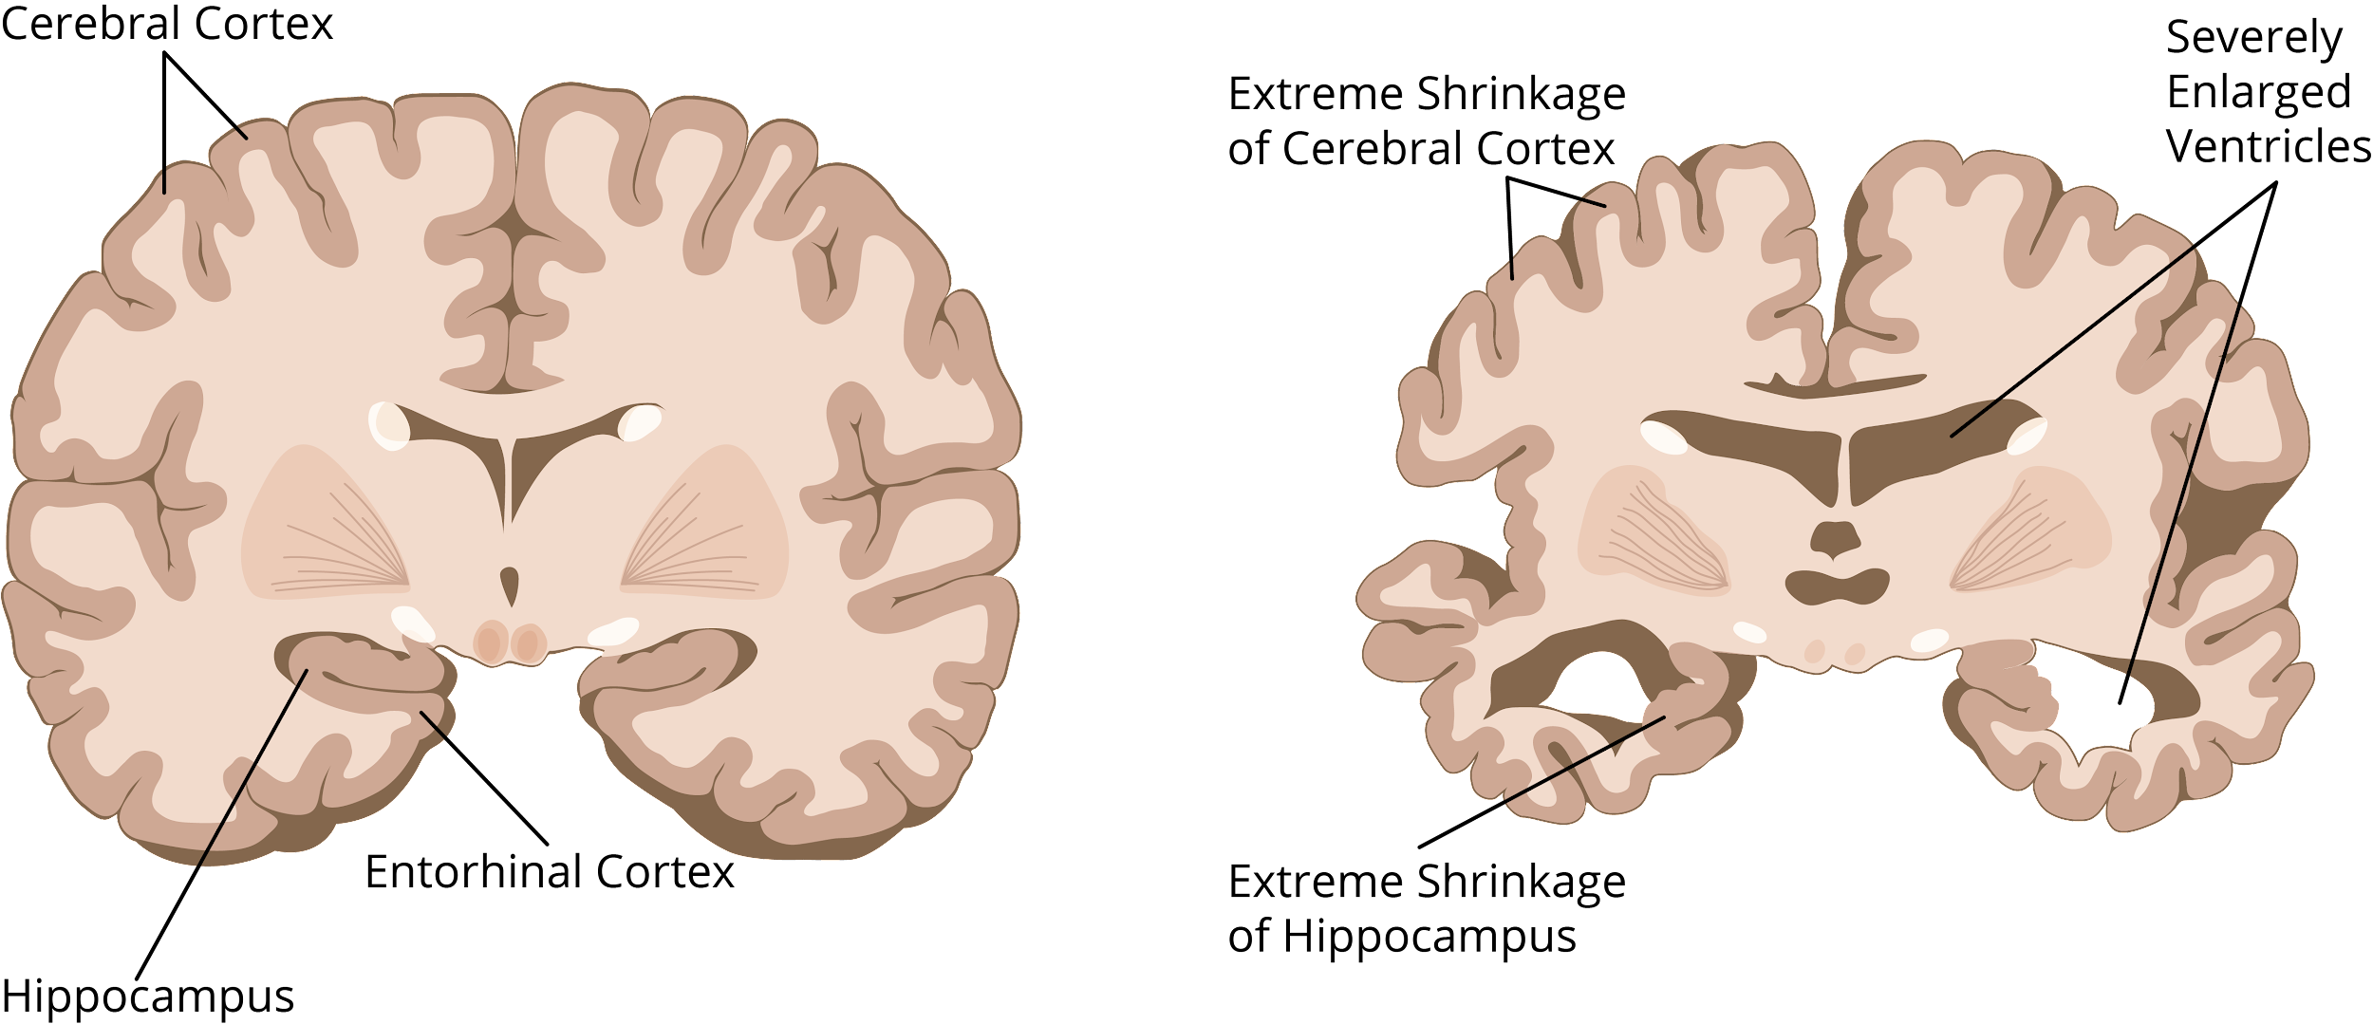
Cell Cycle Diseases and Disorders
Cancer
Nondisjunction disorders
Mosaicism
Alzheimer’s disease
Microcephaly
Psychiatric diseases
Comparison of a normal brain
and one with Alzheimer’s

Slide 23
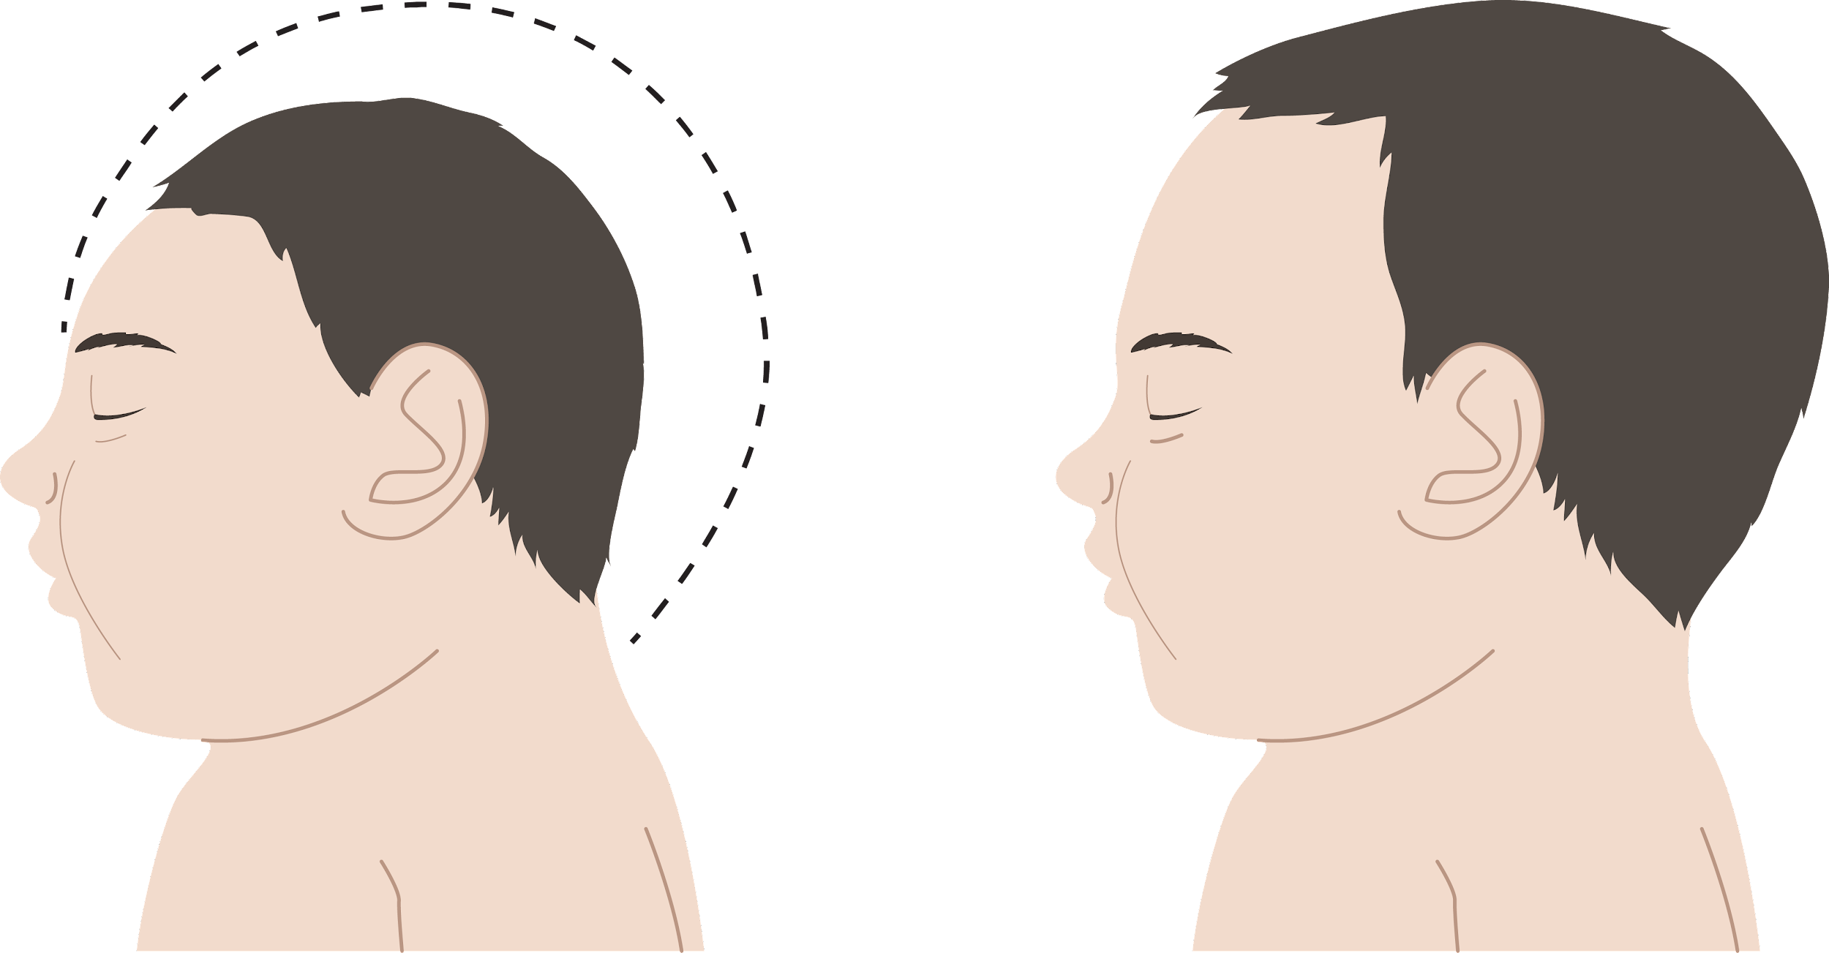
Cell Cycle Diseases and Disorders
Cancer
Nondisjunction disorders
Mosaicism
Alzheimer’s disease
Microcephaly
Psychiatric diseases
Comparison between the head of a baby with microcephaly (left) and a normal baby (right).

Slide 24
Cell Cycle Diseases and Disorders
Cancer
Bipolar disorder
is characterized by manic and depressive episodes.
Nondisjunction disorders
Mosaicism
Psychiatric Diseases
Alzheimer’s disease
Microcephaly
Major depressive disorder
is characterized by severe depressive episodes.
Schizophrenia interferes with a person’s sense of reality.
Psychiatric diseases

Slide 25
A parent cell accumulated a lot of damage to its genetic material. The cell cycle checkpoints were unable to detect the damage and the cell divided. What might happen to the daughter cells?

Slide 26
If errors occur in the cell cycle, the cell will either attempt to compensate for the error through repair processes or undergo apoptosis if the errors cannot be repaired.
In mitosis and meiosis, errors can be passed on in the form of DNA modifications or damage.

Slide 27
The failure of the chromosomes or chromatids to separate properly is known as nondisjunction. This is known as meiotic nondisjunction if it occurs in meiosis and mitotic nondisjunction if it occurs in mitosis.

Slide 28
Cancer is primarily characterized by uncontrollable cell division which results in a neoplasm, which is an abnormal growth of the defective cells.

Slide 29
Aneuploidy occurs when the cell has an abnormal number of chromosomes while polyploidy occurs when the cell has an abnormal number of sets of chromosomes

Slide 30
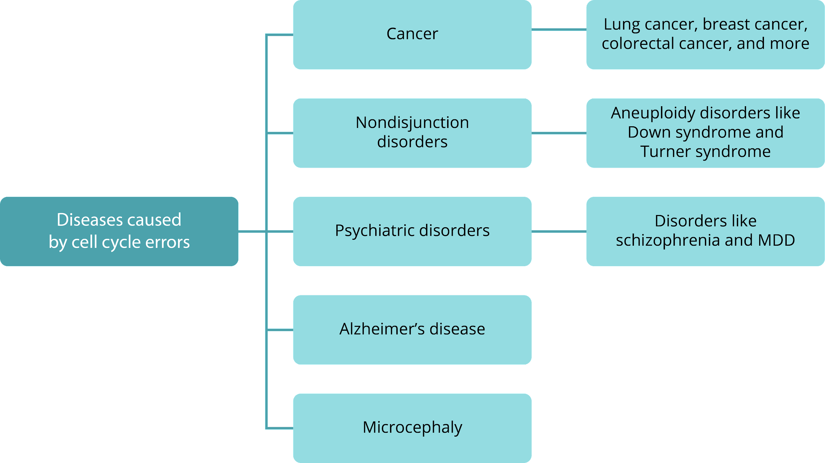
Disorders caused by cell cycle errors

Slide 31
How does nondisjunction lead to the development of diseases?

Slide 32
Slide 21: Full Trisomy 13 phenotype by Vaticidalprophet, is licensed under CC BY 4.0 via Wikimedia Commons.
Slide 23: PortWineStainHand by Aamartinez0626, is licensed under CC BY-SA 4.0 via Wikimedia Commons.
Boyer, Rodney F. Concepts in Biochemistry. Hoboken, NJ: Wiley, 2006.
Hickman, Cleveland P. Integrated Principles of Zoology. New York, NY: McGraw-Hill, 2011.
Miller, Stephen A., and John P. Harley. Zoology. New York, NY: McGraw-Hill, 2010.
Russell, Peter J. Biology: The Dynamic Science. Student Ed. Belmont, CA: Thomson/Brooks/Cole, 2008.
Starr, Cecie, Ralph Taggart, Christine A. Evers, and Lisa Starr. Biology: the Unity and Diversity of Life. Boston, MA: Cengage, 2019.

